Slide 1
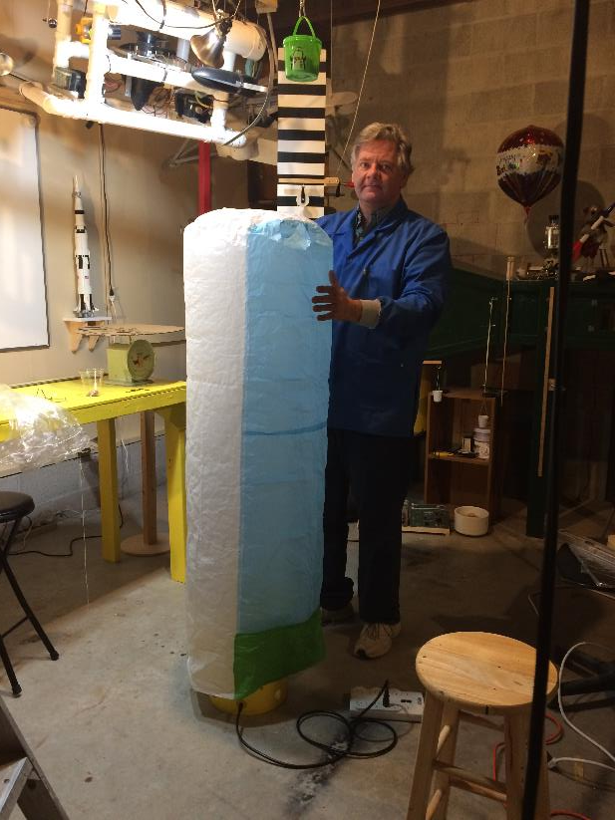
Building a Tissue Paper Hot Air Balloon
LabRat Scientific
© 2018

Slide 2
Precautionary Statement:
Hot air balloon experiments require a source of hot air and light weight materials that could be flammable. Extreme care must be taken to prevent burns to the skin and/or ignition of the balloon material.

Slide 3
Materials
Tissue Paper
White Glue
Yard/Meter Stick
Marking pen
Scissors
Assembly Stand (will make top assembly a little easier)

Slide 4
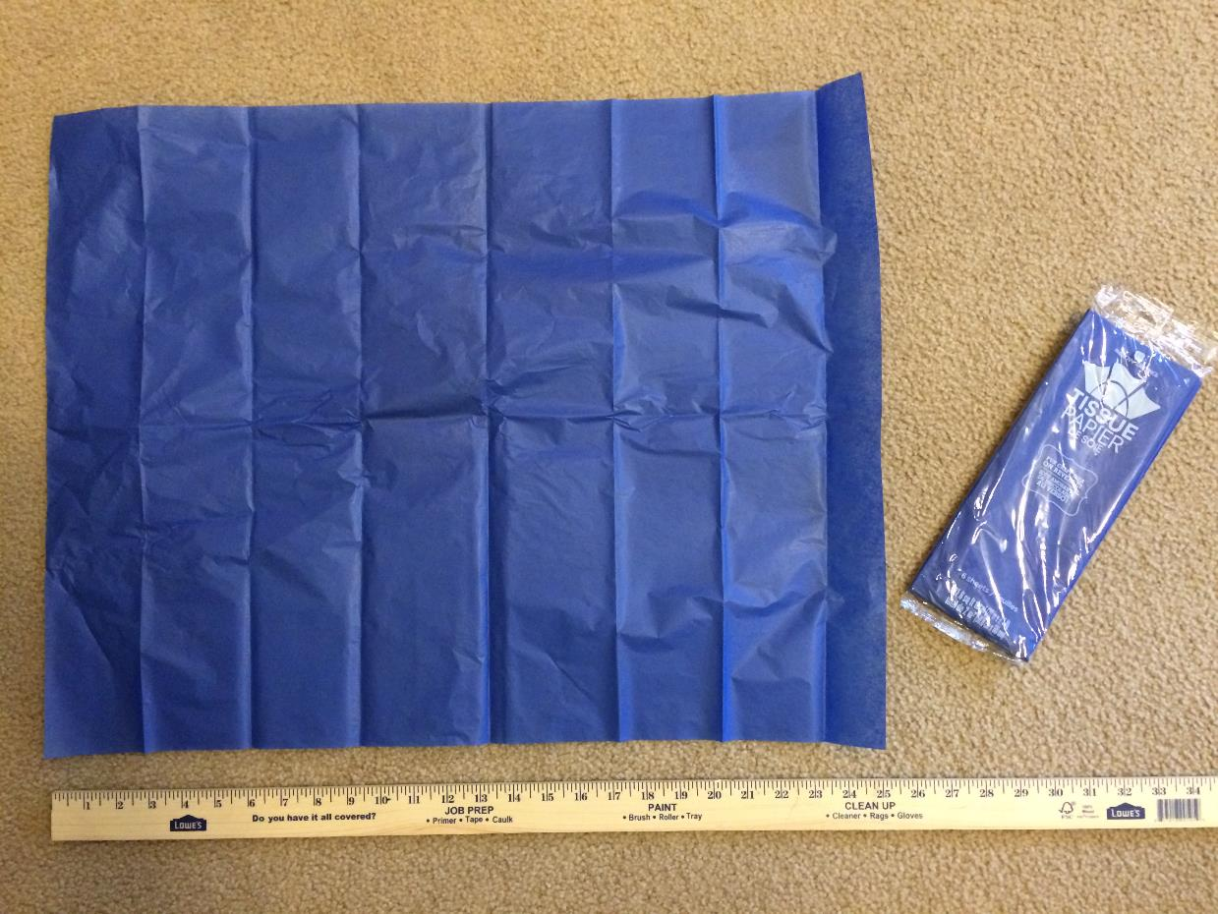
Typical tissue paper. Purchased from a local hobby/craft store.

Slide 5
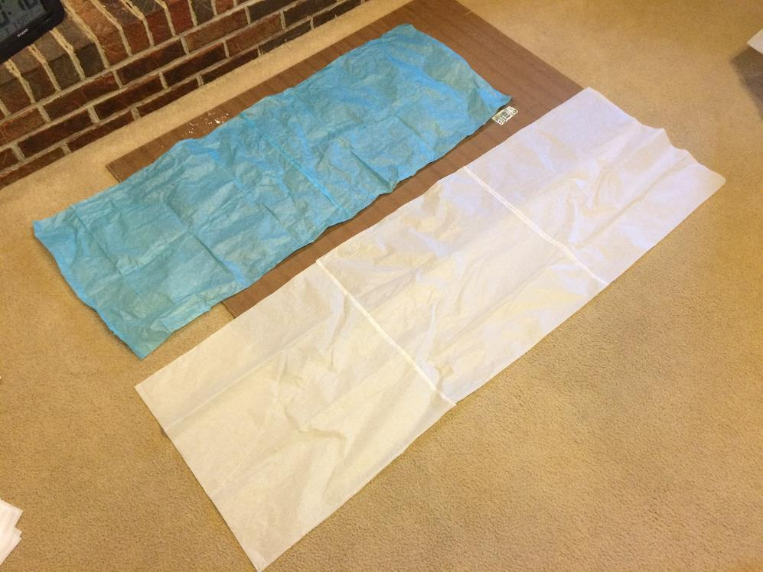
Glue 3 sheets of tissue paper together to make a single “side gore”.
Make three separate side gores.
Using different colored tissue for each gore makes for a more attractive balloon…

Slide 6
Glue the three gores together to form one big square.
Allow the glue to dry, then create a tube.

Slide 7
Now join the free edge of the blue gore to the free edge of the green gore.
Start this step by placing a long sheet of aluminum foil across the balloon.
The aluminum foil keeps the glue from seeping though to the balloon material underneath…
Aluminum Foil

Slide 8
Fold one side of the balloon over top of the aluminum foil.
Lay a thin bead of glue along the free edge.

Slide 9
Now fold the other free edge over top of the foil and about ½ inch overlapping the bead of glue.
Gently press along the glue line to get a good seal.

Slide 10
The end result of the last few steps is a tube of tissue paper (a.k.a Side Tube). The tube is still open at the top and bottom.

Slide 11
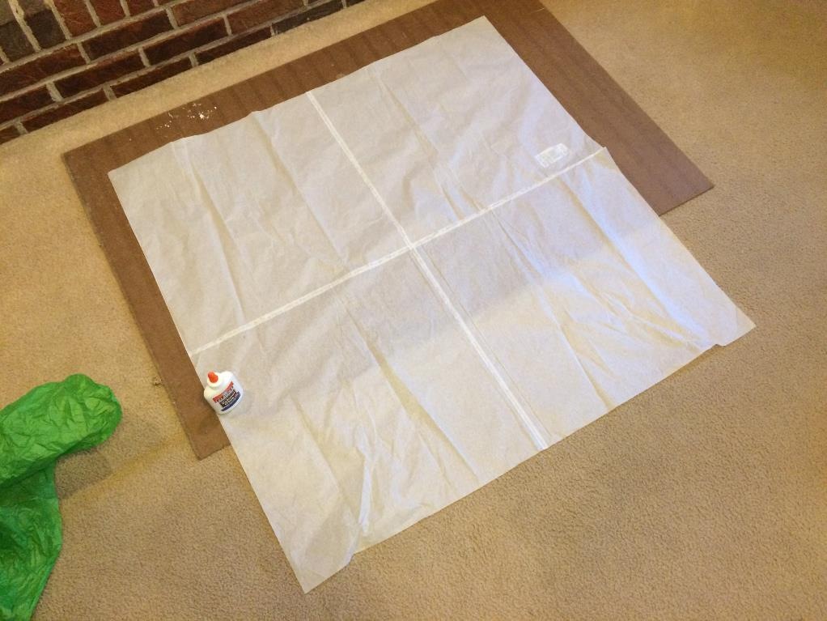
Glue 4 sheets of tissue paper together to make a larger sheet for the balloon top.
This step may not be necessary if your tissue sheets are wider than the balloon diameter.

Slide 12
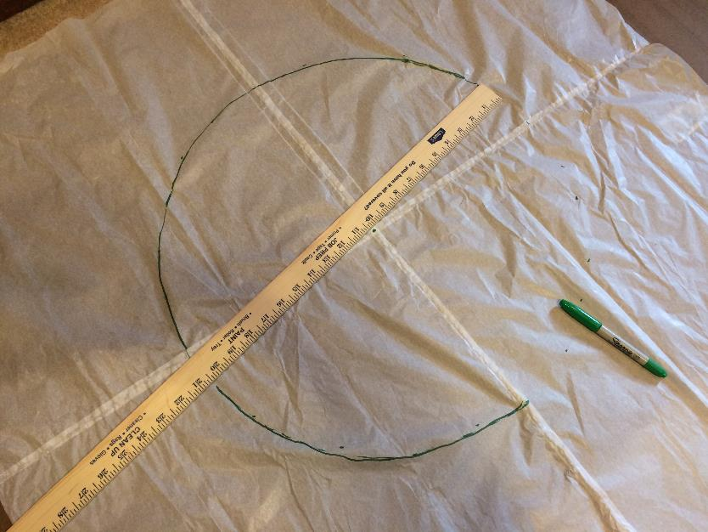
Use a yard stick to mark out the circumference of the balloon top.
For an 18” diameter balloon, make the top disk about 20.5” in diameter. This gives ample overlap to make final gluing easier.

Slide 13
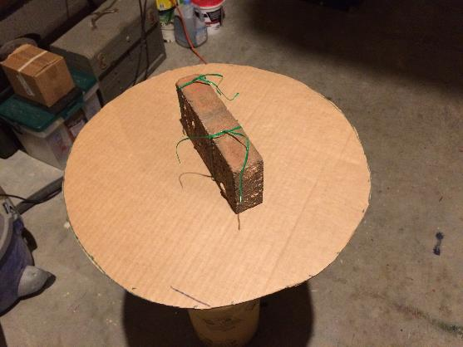
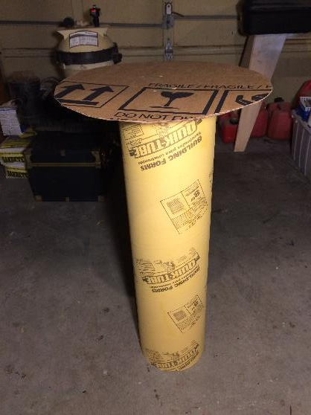
Assembly Stand to assist with attaching the balloon top to the side tube.
Brick attached to the underside of the removable cardboard top. It is held in place with twist ties.
Top placed on the tubular cement form. Brick is located inside the tube. The brick keeps the top from shifting during the balloon assembly process.
The cardboard concrete form can be obtained from a home improvement store.

Slide 14
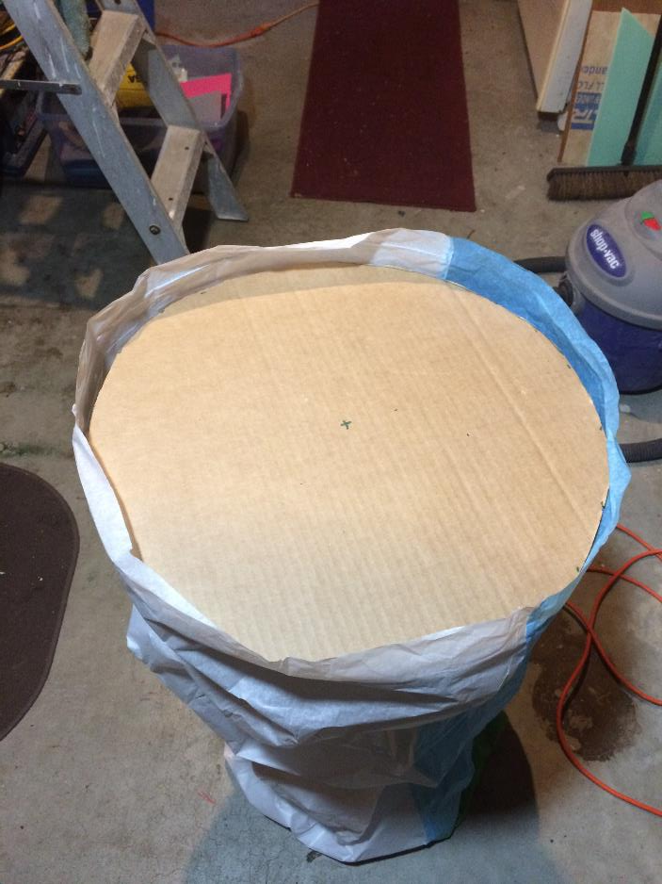
Place the side tube down around the assembly table.
It may actually be easier to remove the card board top and then place the side tube around the base. Then place the top on the stand and pull the side tube up.

Slide 15
Place the tissue balloon top disk on the table top and tuck around the edges.
Balloon Top
Side Tube

Slide 16
Glue Beads
Do not attempt to glue all the way around the circumference at one time when attaching the balloon top.
Place an glue bead at four points as shown. Secure the side tube to the glued area. Make sure the glue does not stick to the cardboard. Let dry, then complete the rest of the gluing.
If you attempt to glue all at once, the top may end up not being evenly distributed…

Slide 17
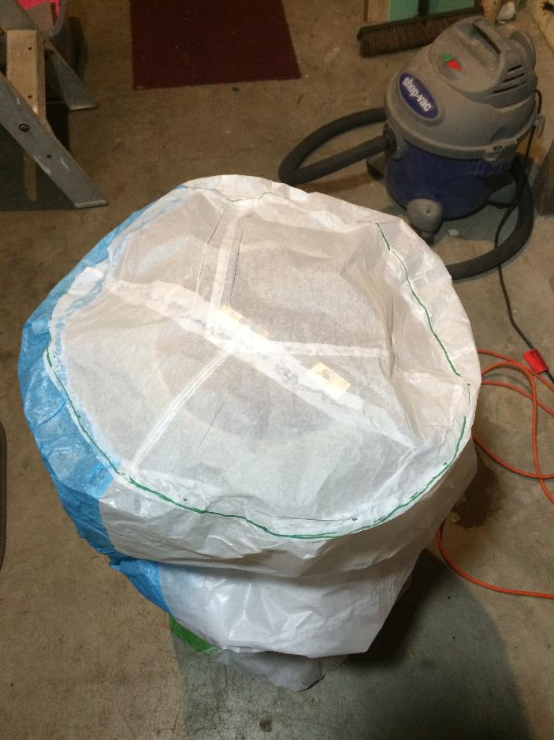
View of the balloon on the assembly stand after the top disk is fully glued in place.
Make sure the balloon material doesn’t get glued to the cardboard assembly stand top…

Slide 18
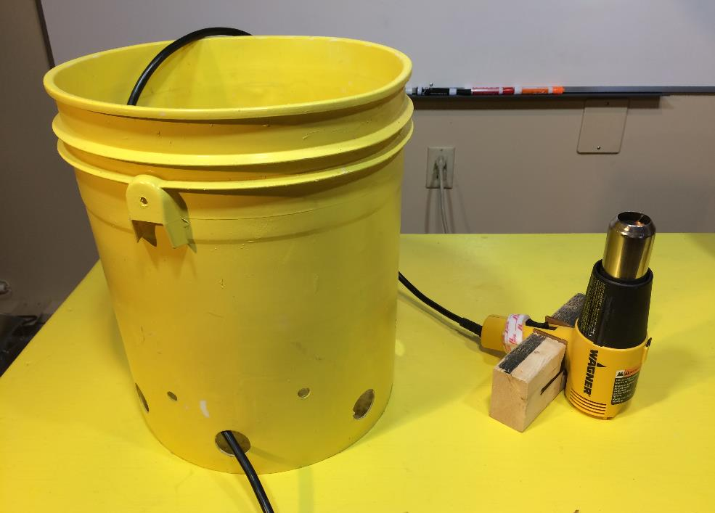
The “Heat Bucket”
A common heat gun is used as the heat source. A simple wood block holder was made to keep the heat gun upright while in the bucket.
Note: A hair dryer will not produce enough heat…
Plastic bucket. A hand drill and a hole saw was used to cut holes along the bottom of the bucket. These holes allow air to be drawn in during the balloon inflation process.

Slide 19
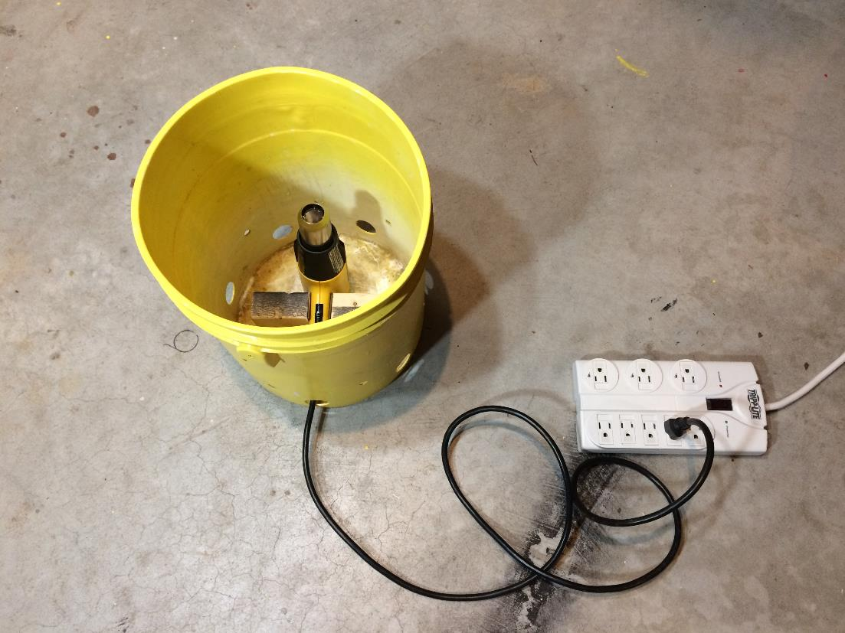
This device helps keep the tissue paper away from the hot heat gun.
While this device makes inflation safer, care must still be taken to keep the tissue paper away from the hot heat gun.

Slide 20
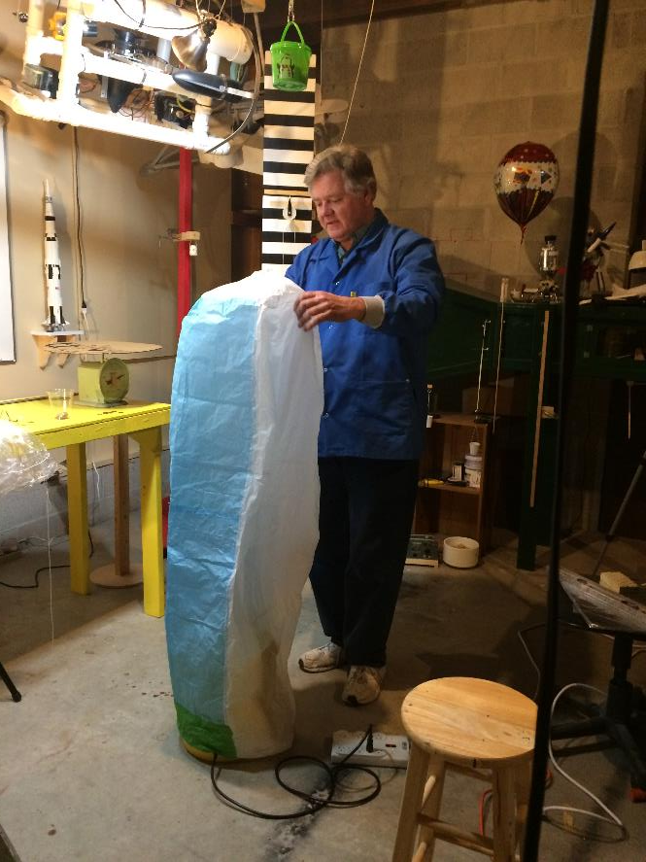
Beginning the inflation process. It will only take a minute or two to get enough hot air to fly the balloon…

Slide 21
Balloon fully inflated and ready for release…

Slide 22
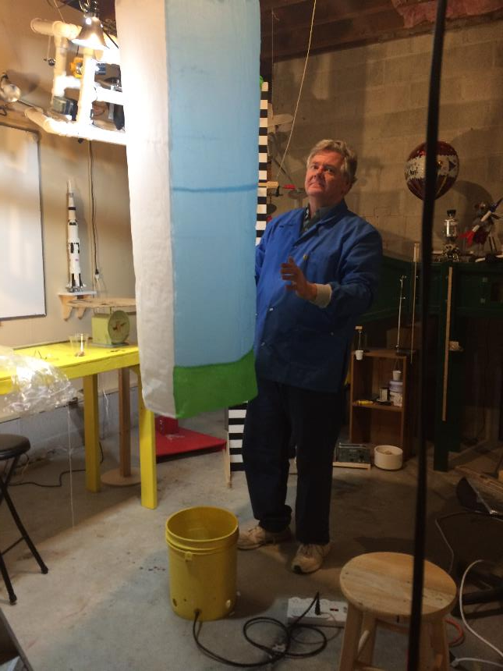
Balloon release…

Slide 23
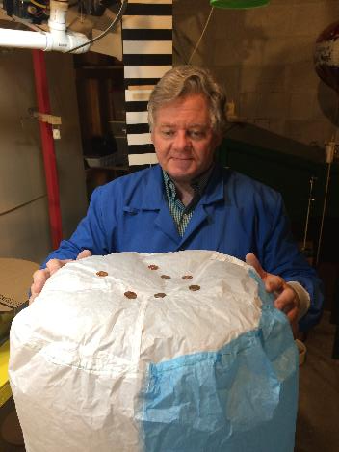
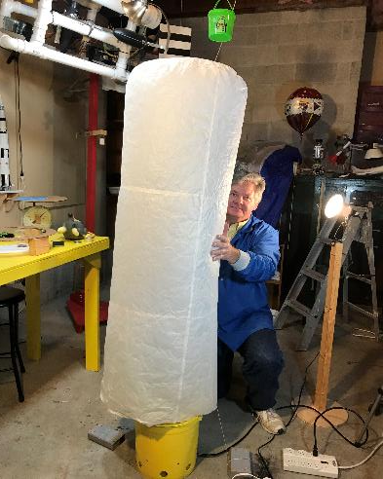
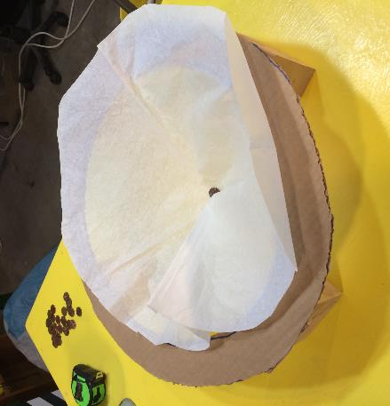
You are now ready to conduct hot air balloon experiments…

